Slide 1
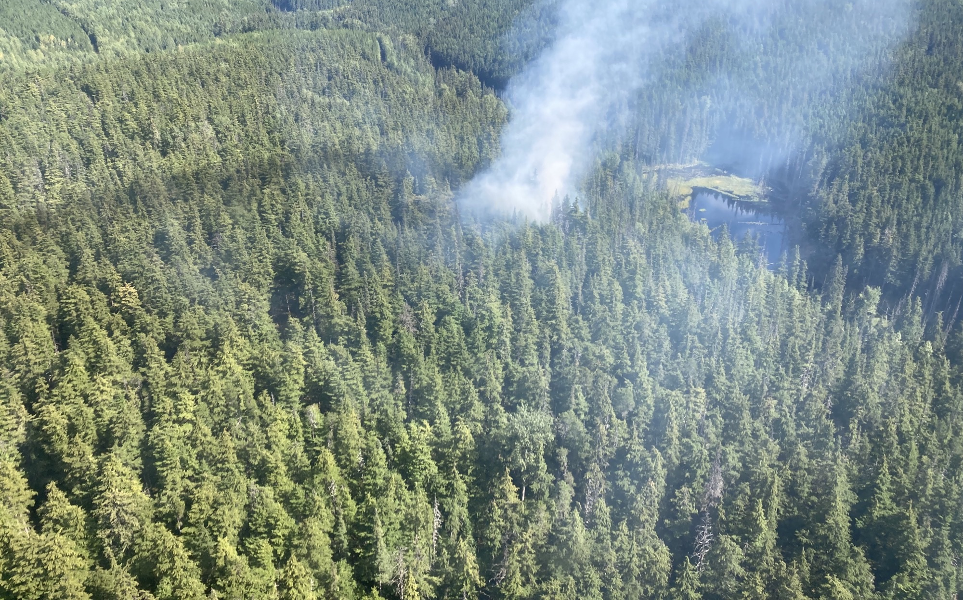
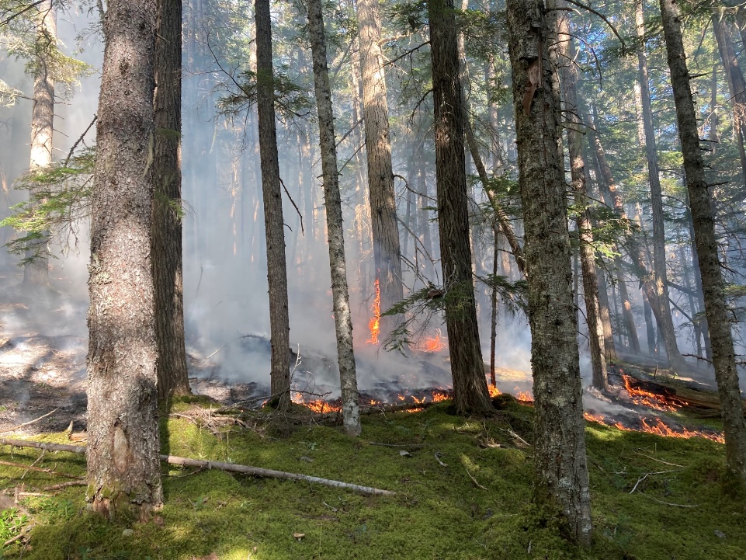
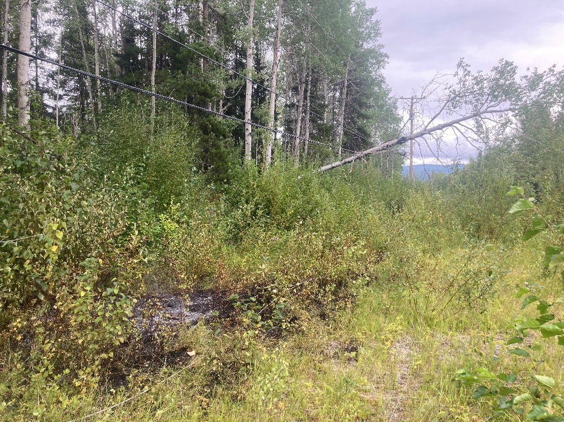
Bulkley Zone – Bulkley and Kispiox TSA’s
Provincial Picture
Bulkley Fire Zone Season Summary
Cultural and Prescribed Fire

Slide 2
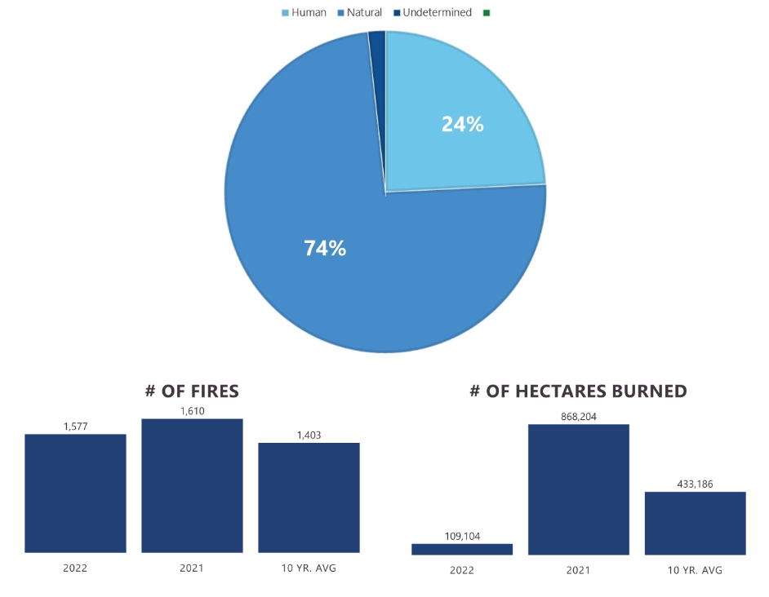
Provincial Picture
2022 Season Summary Coming soon
https://www2.gov.bc.ca/gov/content/safety/wildfire-status/about-bcws/wildfire-history/wildfire-season-summary
Above average starts below average hectares burned.
Slow start, prolonged season.

Slide 3
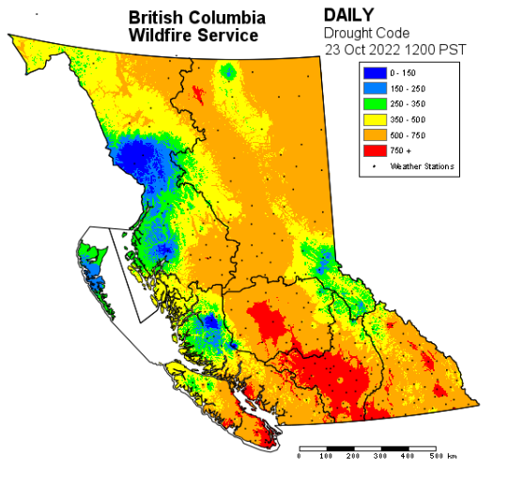
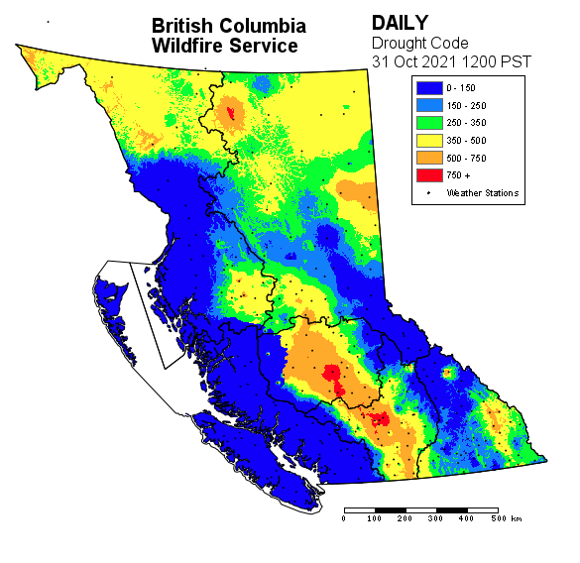
Provincial Picture
1
2
3

Slide 4
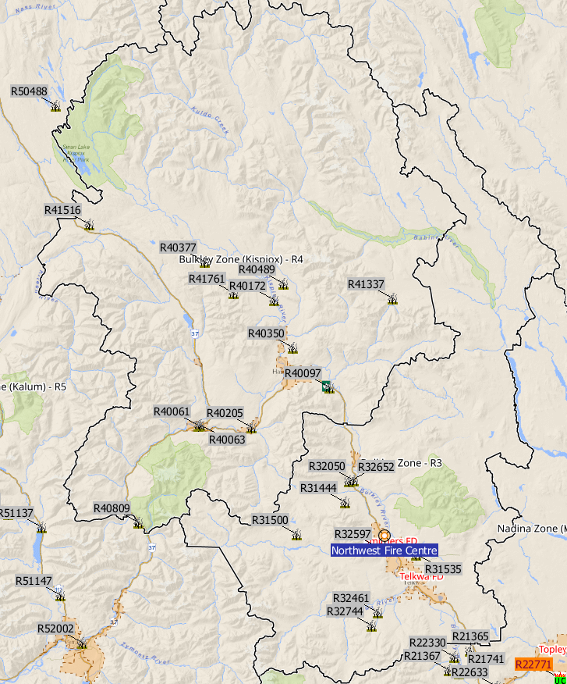
Bulkley Fire Zone Season Summary
Fires: 20 , 26.7 ha
11 human
9 lightning
Nuisance: 7
Average fire load 2022
2023 – watching the drought codes

Slide 5
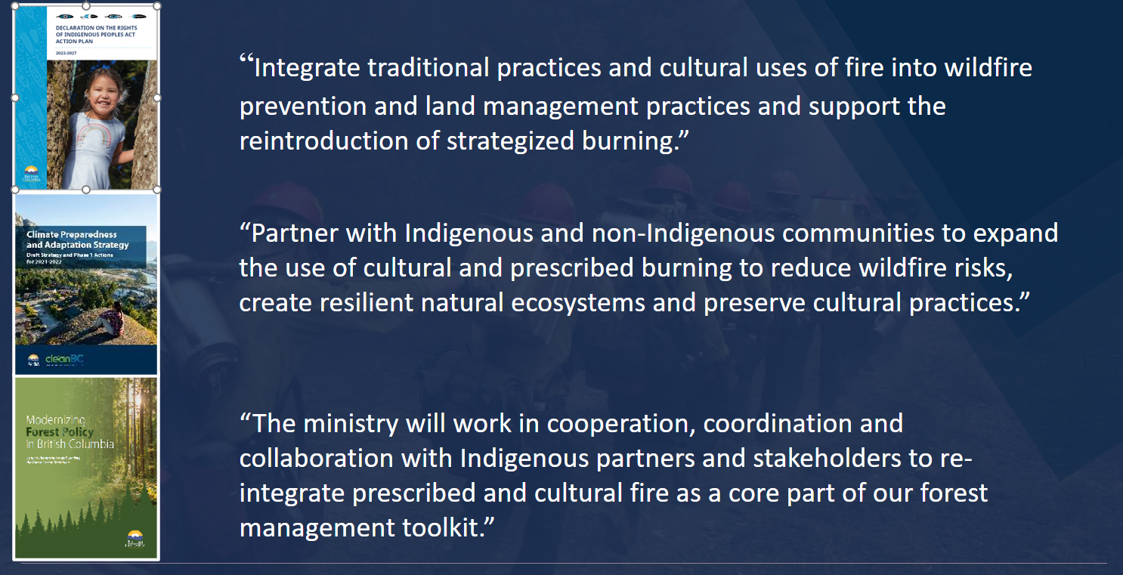
Cultural and Prescribed Fire – Governments Direction

Slide 6
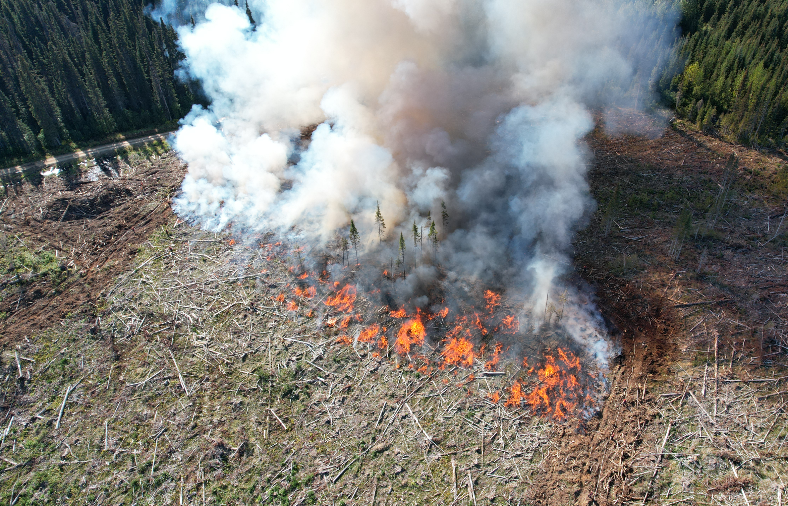
Climate Change Adaptation Trials
“Primarily, operational trial to investigate the effect of prescribed burning on a range of species and seed lots for climate adaptation.”
“ Supports government direction objectives for implementing Climate Based Seed Transfer and Climate Change informed Species Selection for climate adapted reforestation.”
Proponent : Office of the Chief Forester contract support from Larry McCulloch
Partners: PIR, BCWS
CP 573 and 574 near Fort Babine 2 units totaling 3.9 ha
CP 400-404 Old Fort FSR 1 unit 13.2 ha

Slide 7
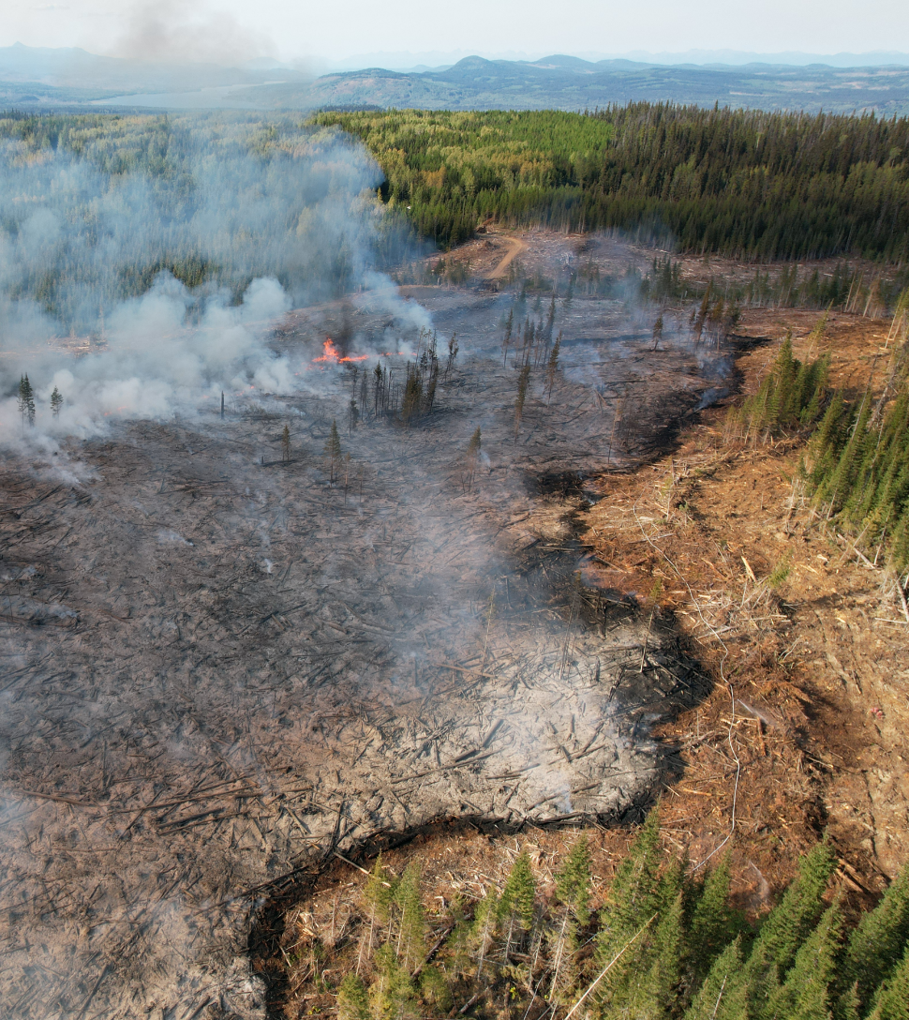
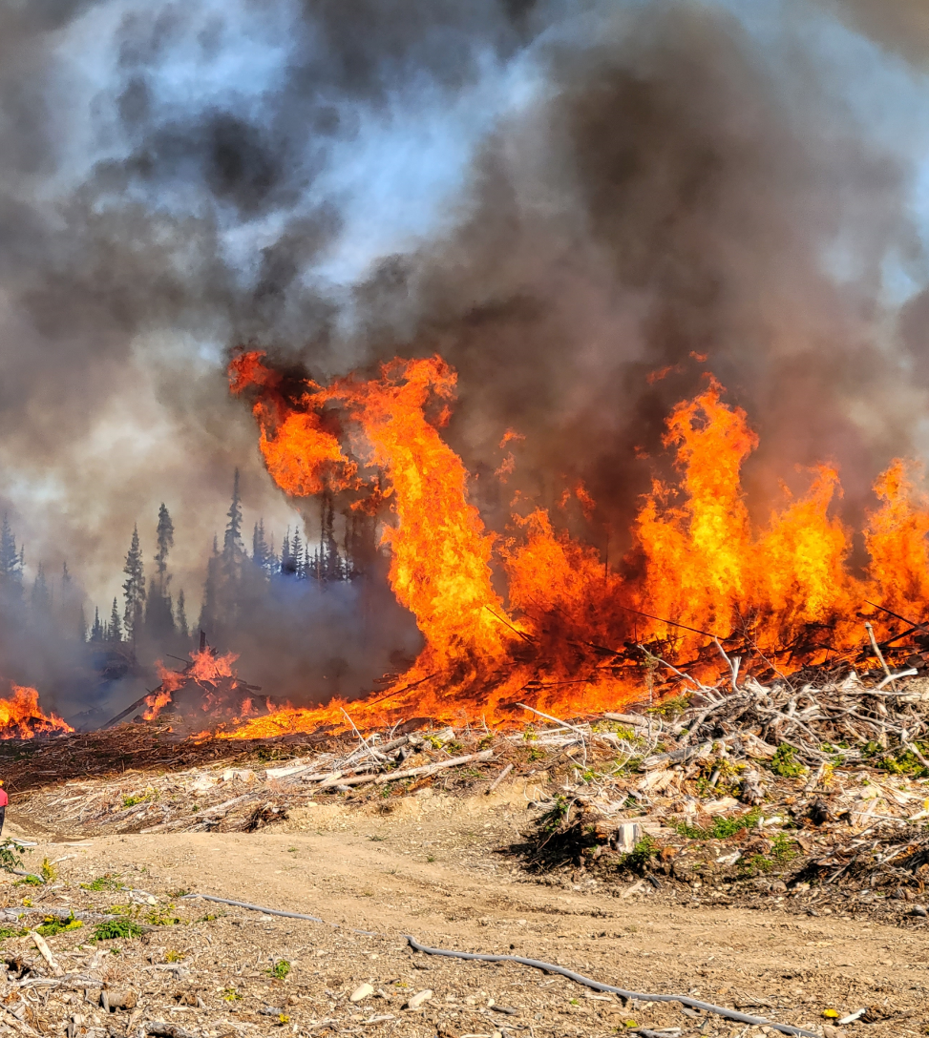
Climate Change Adaptation Trials

Slide 8
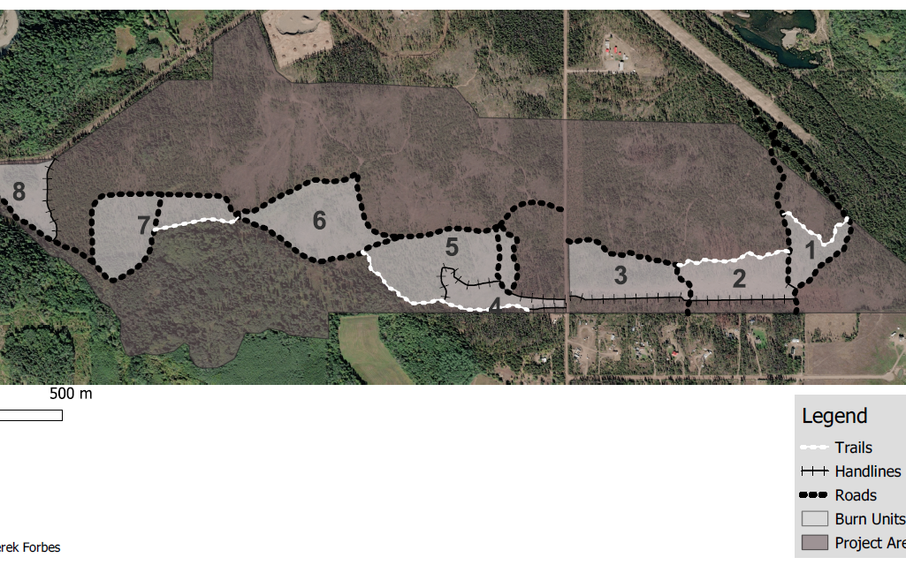
Jackpine Skillhorn Rx Fire Project
Develop
Develop resiliency to future wildfire threat by ensuring that wildfire risk reduction objectives are continuously met in strategic areas surrounding the Village of Telkwa.
Reduce
Reduce the ingress of natural regenerating vegetation, surface fuel loading and raise the height to live crown of overstory trees while retaining forest cover for wildlife and visual quality purposes.
Expand
Expand the knowledge, experience, and opportunities within BCWS and associated partners for prescribed fire planning, implementation, and monitoring.
Increase
Increase the public awareness on the use of prescribed fire in the Bulkley Valley.

Slide 9
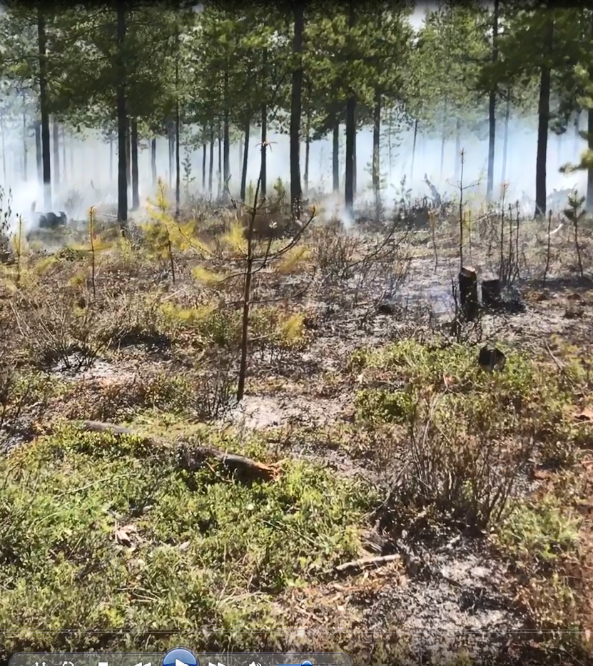
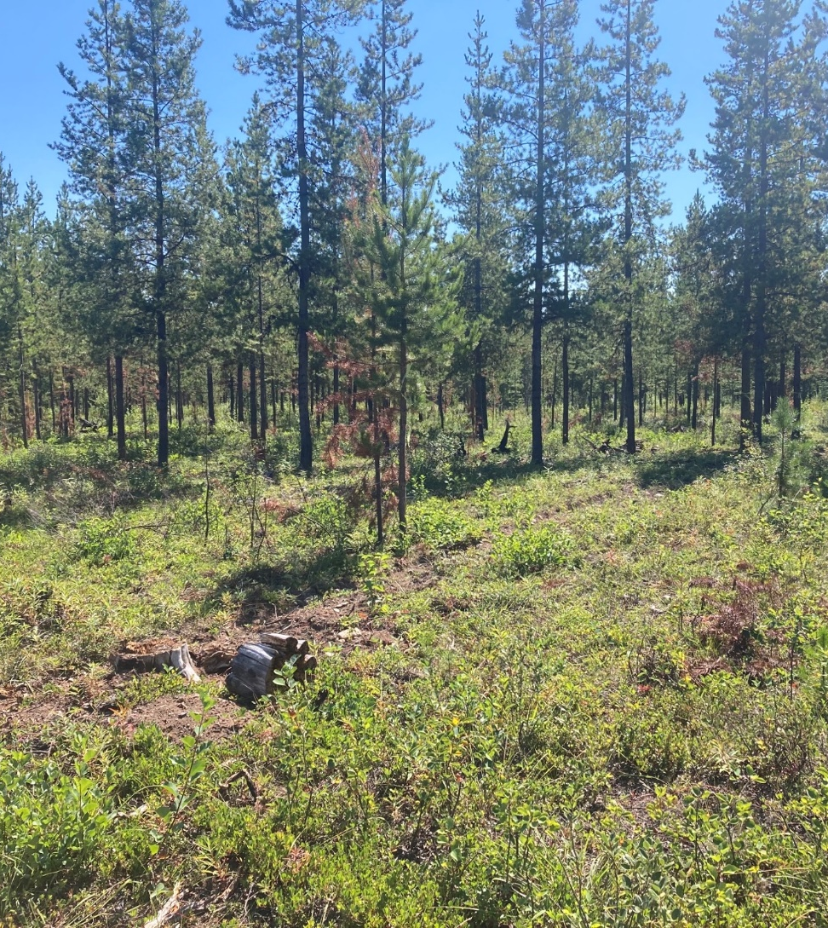
Jackpine Skillhorn Rx Fire Project

Slide 10
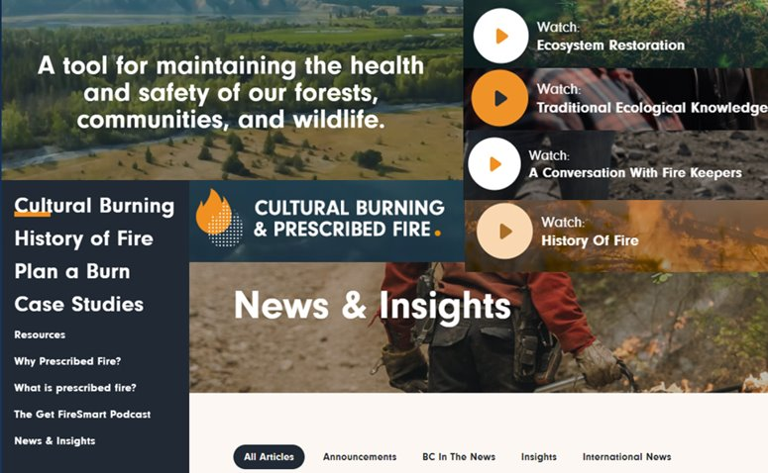
PrescribedFire.ca

Slide 11
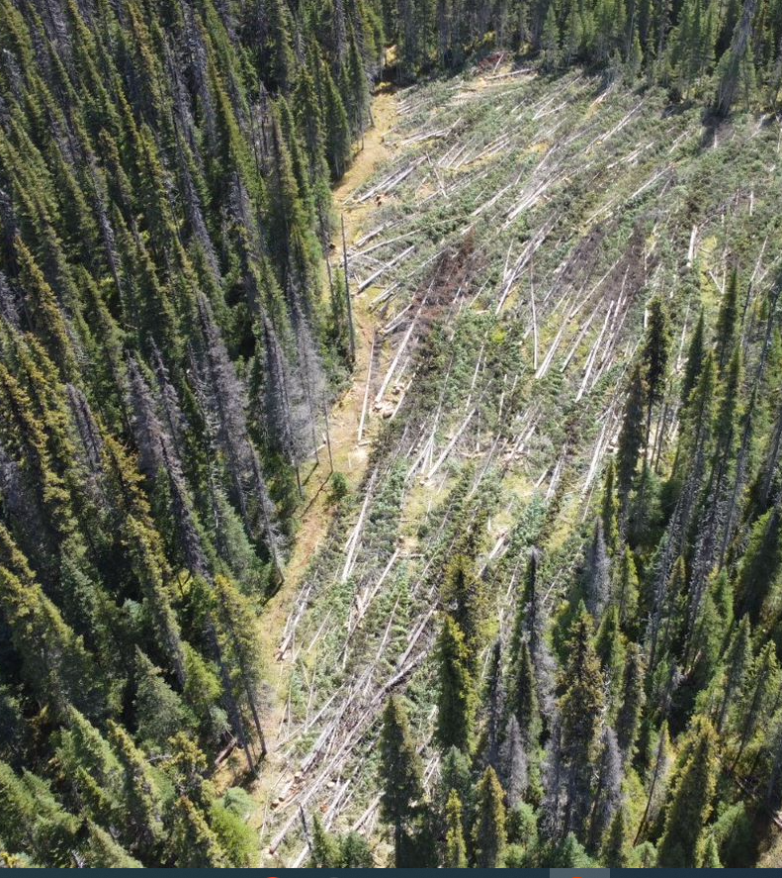
Faller Development
Thanks for the support in developing our professional fallers.
PIR
Hudson Bay Mountain
BCTS – Hazelton
Woodlot Licensees
Skeena Region Beetle Program
We are always in search of falling sites……….

Slide 12
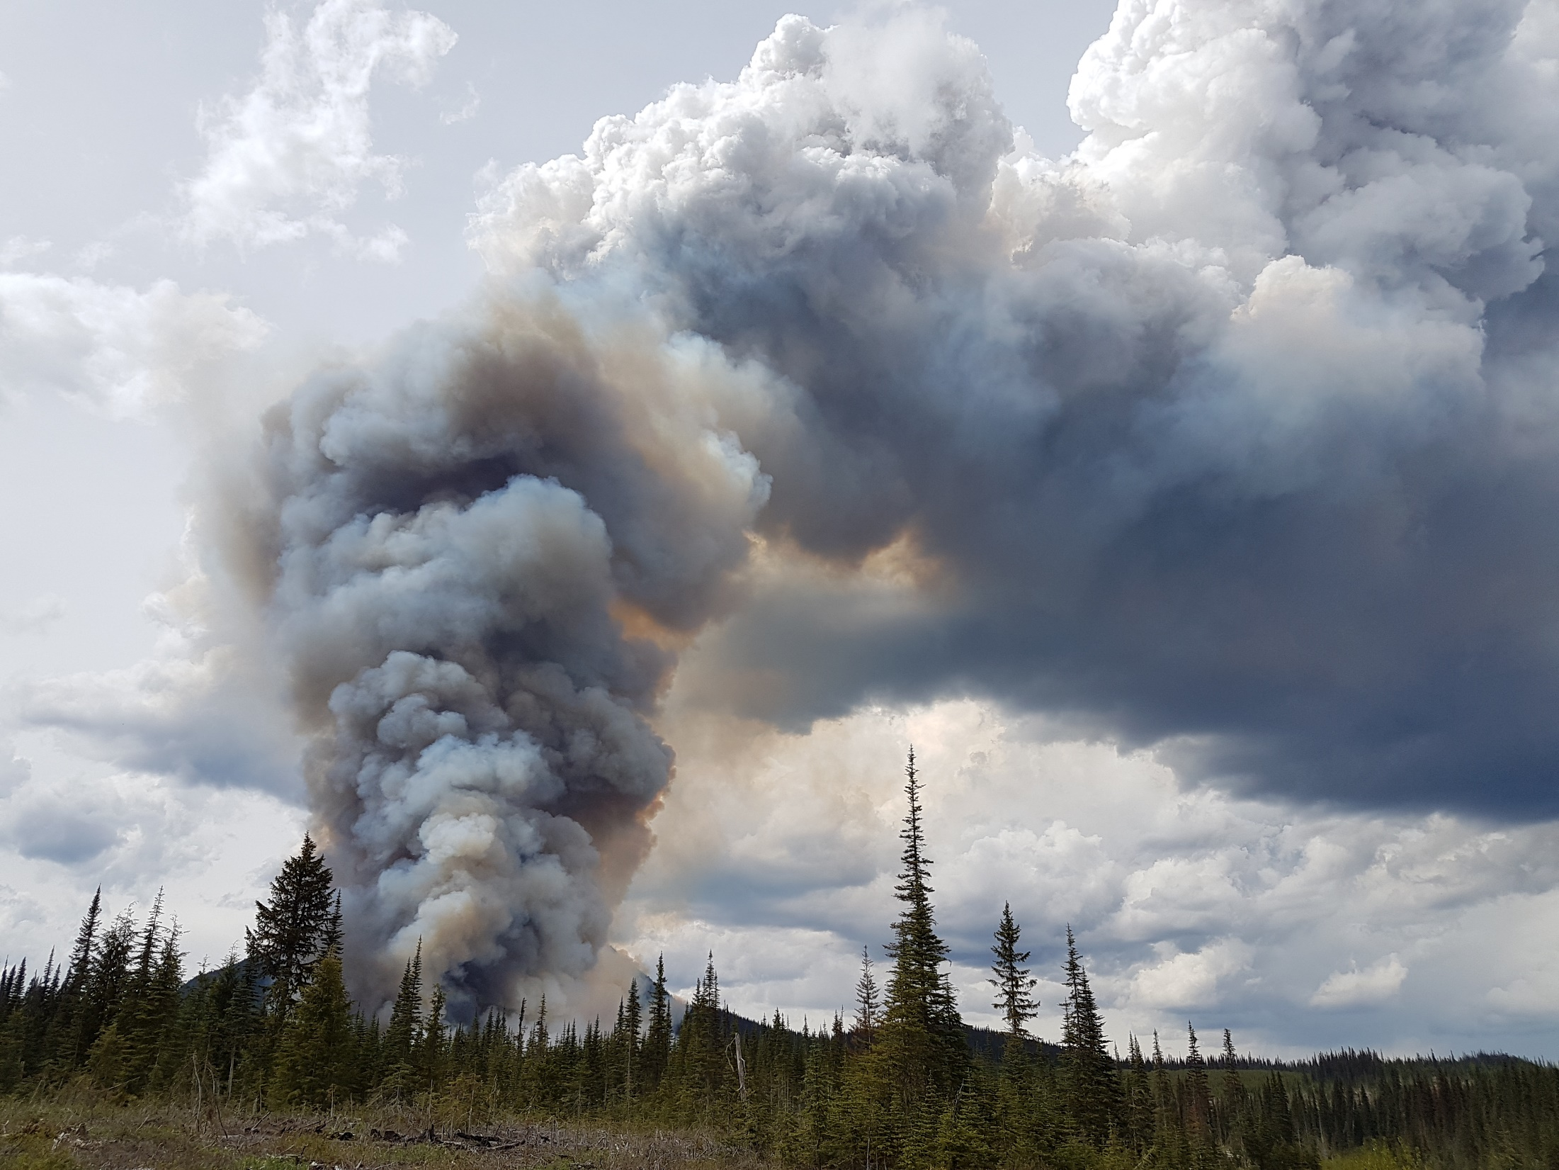
Questions or Comments Call Anytime
Jeff Walsh Bulkley Zone Wildfire Officer
250-643-1279 jeff.walsh@gov.bc.ca
Bulkley Zone Wildfire Coordination Officer
250-643-8164 BCWS.NWFCBulkleyZWCO@gov.bc.ca

